Slide 1


Fault Tolerance Techniques in the Branch Prediction Unit
Master Thesis
by Filippos Filippou
Supervisors:
Prof. Dimitris Nikolos
Dr. George Keramidas
M.Sc. Hardware-Software Integrated Systems

Slide 2
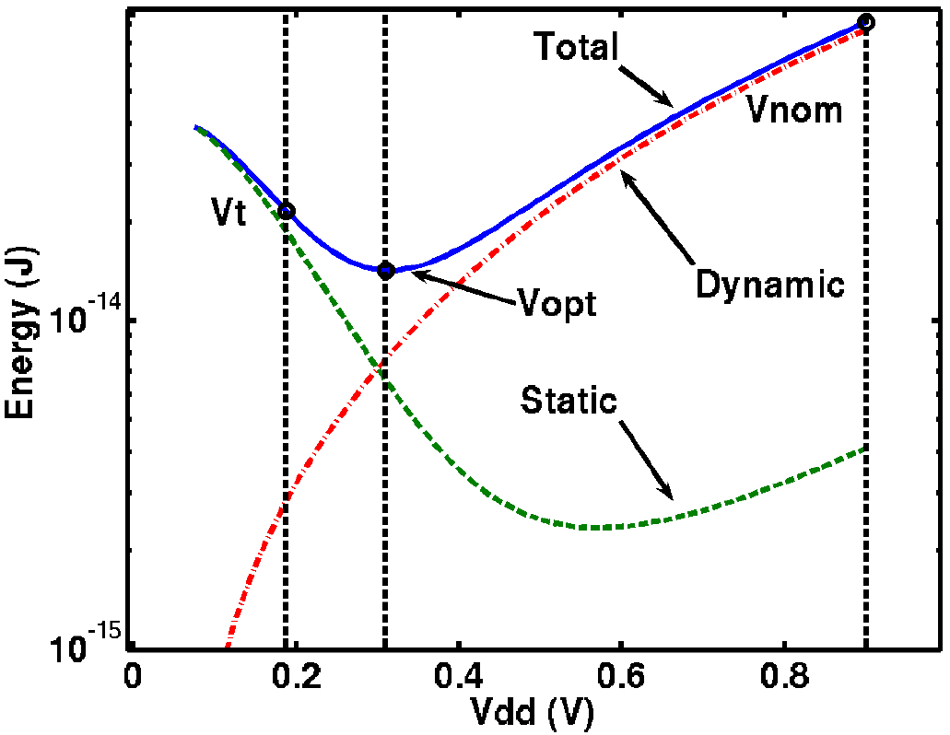

Introduction
LOW POWER: the main target in computing design
Both in high-end and in low-end systems
Many proposals in ultra-low voltage operation ⇨ reliability issues
The biggest failure → On-chip memories suffers the most
smaller transistors ⇨ more prone to failures
Source
Pinckney, Nathaniel, et al. "Assessing the performance limits of parallelized near-threshold computing." Design Automation Conference (DAC), 2012 49th ACM/EDAC/IEEE. IEEE, 2012.
$$P_{dynamic}=C× V_{dd}^{2}×f_{clk}$$
Filippos Filippou

Slide 3
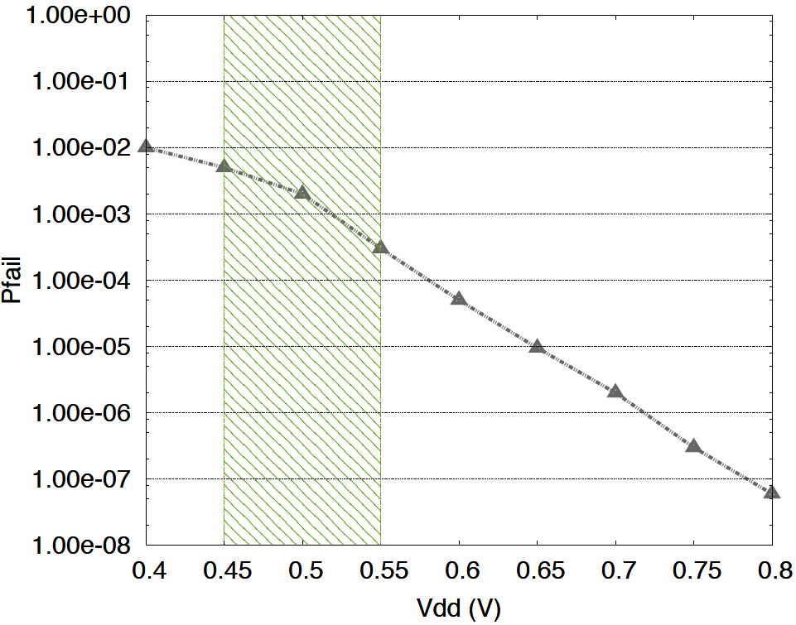
Probability of Failure
Lower Supply Voltage ⇨ More malfunctioning memory cells
Reaction: Fault tolerance techniques tailored to on-chip memory structures
Source
Ferrerón, Alexandra, et al. "Block disabling characterization and improvements in CMPs operating at ultra-low voltages." Computer Architecture and High Performance Computing (SBAC-PAD), 2014 IEEE 26th International Symposium on. IEEE, 2014.
Filippos Filippou

Slide 4
Fault Tolerance in Branch Prediction
Many approaches in cache fault tolerance techniques
Little attention in other on-chip (inside the core) memory structures
Contribution of the this work:
The first fault tolerance technique for Branch Target Buffer (BTB) memory structures targeting to reduce the performance degradation and energy increase due to faulty SRAM cells in Branch Prediction Mechanism
Filippos Filippou

Slide 5
The Branch Prediction Mechanism (1)
Υ = 1
Υ == 0 ?
(Branch)
Branch Instructions and Subroutines change the execution path
Prediction of Conditional Branches: depends on a previous instruction’s result in order to determine the correct execution path
BPBs: provide a prediction if branch is “Taken” or “Non-Taken”
BTB: if branch is “Taken” → provides a prediction about the TARGET address
Mispredictions in BPU ⇨ Wrong Path ⇨ Performance Slowdown
And how it works?
Filippos Filippou

Slide 6
Tournament Branch Predictor
But how much important is this prediction?
Filippos Filippou

Slide 7
Tournament Branch Predictor
But how much important is this prediction?
Filippos Filippou

Slide 8
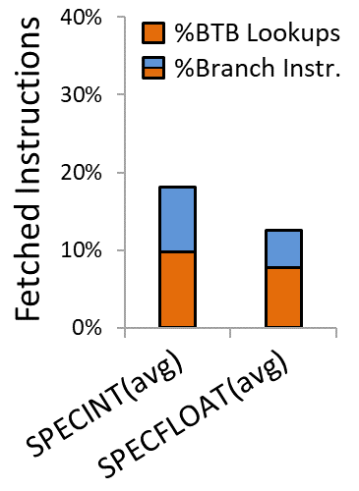
Is a prediction so much important ?
Pipeline without branch predictions →
60% reduction in performance!!!
Q1: What is the percentage of branch instructions
Q2: How many instructions use BTB to predict the correct path
Integer / Floating Benchmarks:
18% / 12% branch instructions
10% / 8% of instructions accesses BTB
What can be the impact of a faulty BPU?
Filippos Filippou

Slide 9
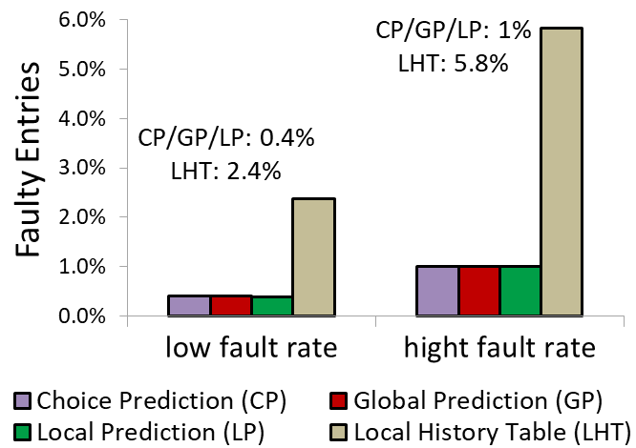
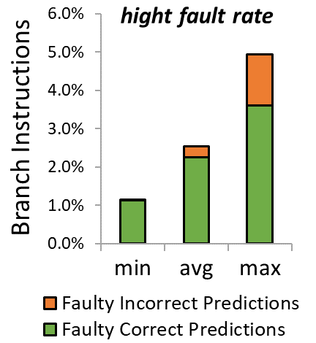
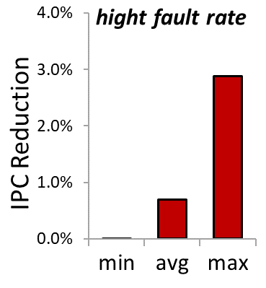
Impact of Faulty BPBs
More error resilience BPBs or not?
Faulty Prediction ⇏ Incorrect Prediction
(worst case: only 1.3% of predictions are faulty & incorrect)
Slowdown in high fault rate: 0% / 0.7% / 2.9% (min – avg – max)
Fault tolerance is NOT necessary in BPBs!
So, what about BTB?
Filippos Filippou

Slide 10
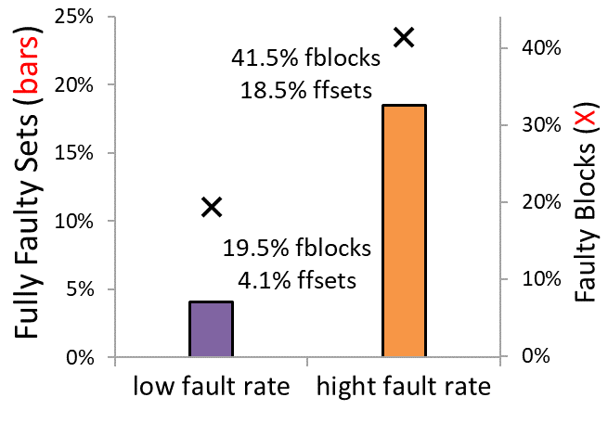
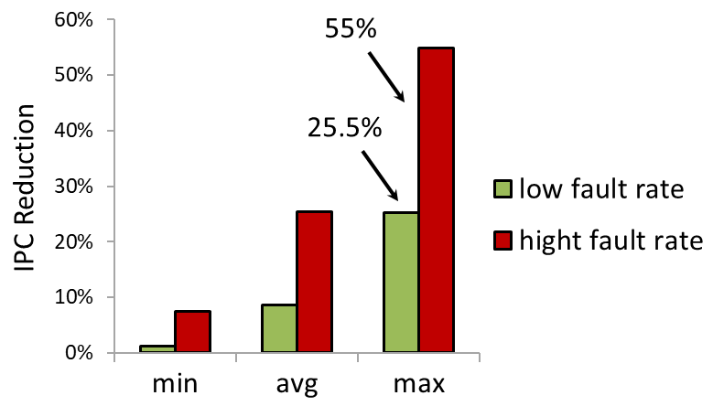
Impact of Faulty BTB ?
Is it worthwhile a more error resilience BTB?
Slowdown in low fault rate: 1.2% / 8.6% / 25% (min – avg – max)
Slowdown in high fault rate: 7.5% / 26% / 55% (min – avg – max)
Yes, WE MUST build more fault resilient BTBs!
But how? → Lets study BTB behavior with & without faults
BTB: 2048/2-way
Filippos Filippou

Slide 11
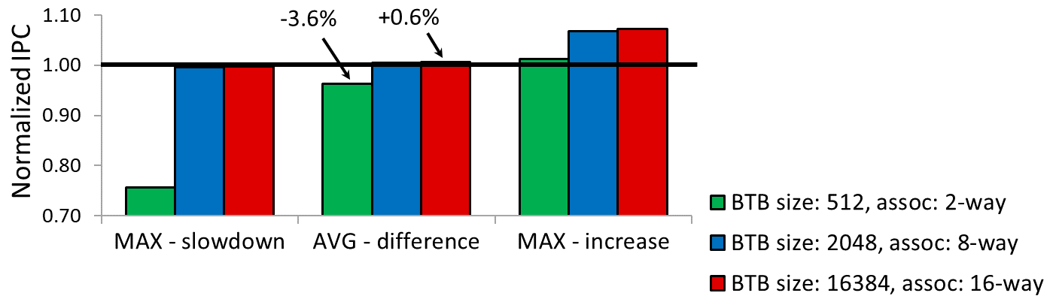
Impact of BTB configurations (FAULT FREE CASE)
Q: Does the BTB size plays a significant role?
Conclusion 1:
Reduction of size to ¼ (blue to green bars)→ less than 4% IPC reduction (avg)
Conclusion 2:
Compared to infinite BTBs (red bars) → no improvement
2048-entries/2-way ΒΤΒ ⇨ high IPC ratio & low latency
Wait: Something is going on here!
Fault free
Case
(vs 2048/2-way)
Filippos Filippou

Slide 12
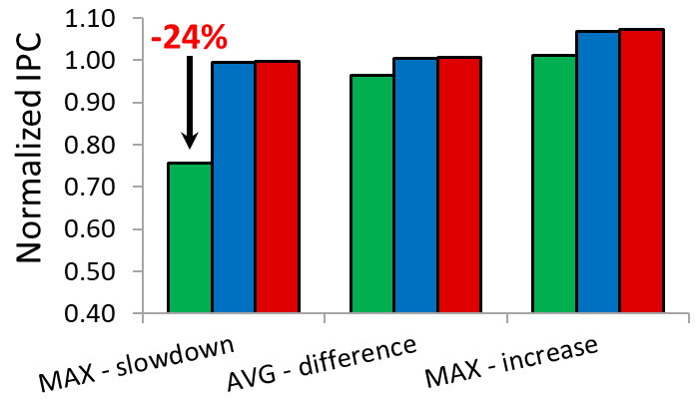
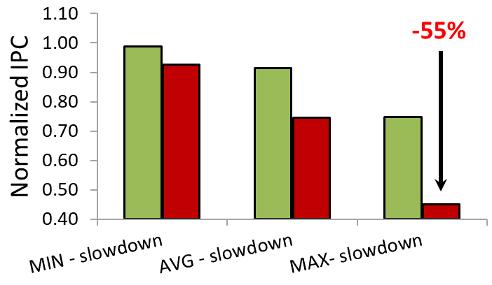
What is wrong ???
FAULT FREE BTB: Reduction of size by 75% ⇨ in worst case 24% IPC reduction
FAULTY BTB: 40% faulty blocks (pfail:5e-3) Reduction of size by 40% ⇨ in many cases IPC reduction > 50%
Why this strange behavior?
culprit → Fully Faulty Sets
Fault Free Case
Faulty Case
Norm. IPC = 1.00 -> BTB: 2048/2-way
Filippos Filippou

Slide 13
Target in BTB Fault Tolerance Mechanism
Fully Faulty Sets: sets without any healthy block
Can cause a significant performance degradation!
FT techniques for Caches vs BTB → different targets
Adapting from FT Caches → DOES NOT WORK
most Cache fault tolerance → optimized to increase the fault-free area
Our finding:
BTB fault tolerance → optimized to decrease the number of
fully faulty sets and not the faulty area
A new mechanism must be developed!
>> Example: Excessive case of a 4-way BTB
Filippos Filippou

Slide 14
Permutation Mechanism – Example (1/4)
A faulty ΒΤΒ example
The Target: Minimize the fully faulty sets
Filippos Filippou

Slide 15
Permutation Mechanism – Example (2/4)
STEP 1: XOR between faulty blocks
A Configuration Register (CR) per Way:
Logical Set =
Physical Set
XOR
CR (Way-i)
Initially:
Logical Sets same as
Physical Sets
The Actual Target:
Calculate values for CRs that minimize the fully faulty logical sets
Filippos Filippou

Slide 16
Permutation Mechanism – Example (3/4)
STEP 2-3: XOR between faulty logical sets & faulty blocks
Filippos Filippou

Slide 17
Permutation Mechanism – Example (4/4)
After our mechanism → no fully faulty logical sets exist any more
( Detailed examples can found in thesis )
Is that enough?
Filippos Filippou

Slide 18
Optimized Permutation Mechanism
Some cases cannot be resolved, what to do next?
→ Use MORE CRs PER WAY !!!
Okay, but what about the additional cost ?
Filippos Filippou

Slide 19
Permutation Mechanism - Overhead
Hardware overhead:
Calculated using CACTI
For a 2^{N} number of associative sets BTB with 2^{K} CRs/way:
(N-K) 2-bit XOR gates / way
2 (N-K)-bit Config. Register / way
1 faulty-bit / block
BTB: 2048-entries/4-way & 2 CRs/Way
→ N = 9, K = 1
32 x XOR gates, 8 x 8-bit CRs, 2048 faulty-bits
(< 1% of the original design)
>> Negligible hardware overhead compared to the original design!
Filippos Filippou

Slide 20
Simulation Framework
gem5, x86 out-of-order architecture, cycle accurate simulations
McPAT, power, area, and timing modeling framework (90nm - 22nm)
8-issue pipeline
Local & Global Meta-Predictor
Cache hierarchy: DL1, IL1, LLC (L2 )
LLC Stride Prefetching
Benchmarks: SPEC 2006
Nominal frequency: 2.5GHz
Failure Probabilities: 2e-03 (470mV, 1.1GHz) & 5e-03 (420mV, 0.5GHz)
BTB configurations: 2048-entries/2-way & 2048-entries/4-way
100 faulty cases (fault maps)
Filippos Filippou

Slide 21
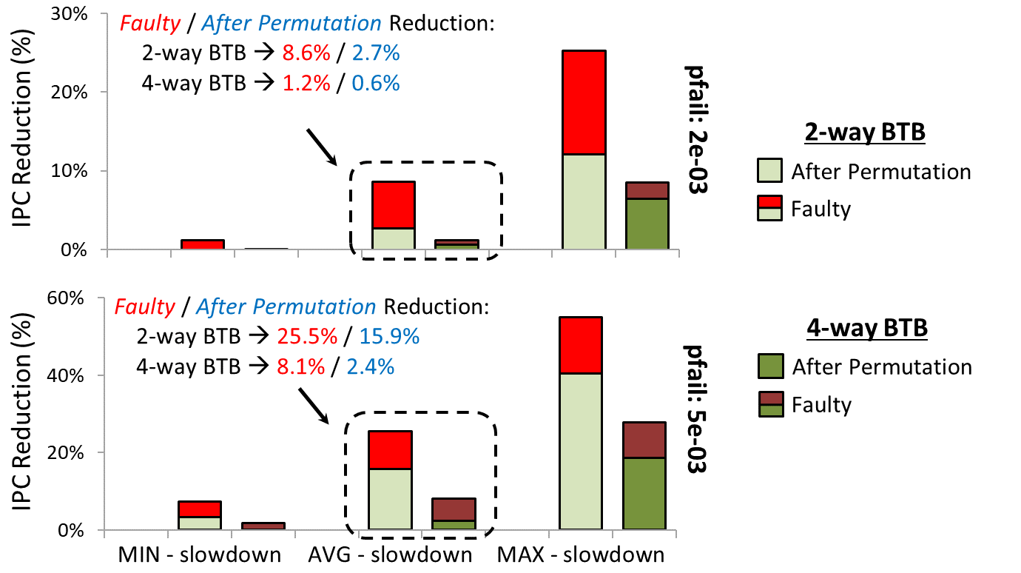
Evaluation Results - IPC (Min/Avg/Max)
40% ∼ 70% performance recovery on average!
Performance ⬆
Filippos Filippou

Slide 22
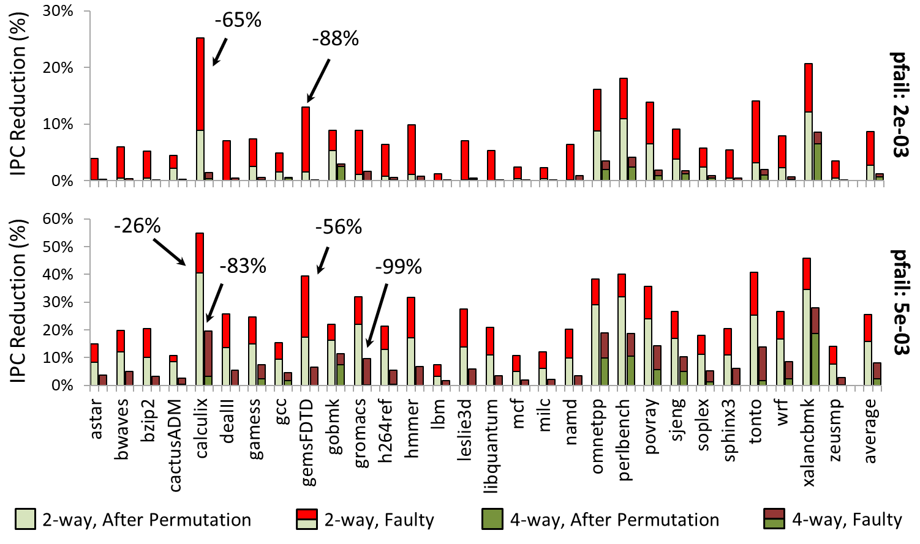
Evaluation Results - IPC (Total)
Significant cases with even more than 70% IPC recovery!!
Filippos Filippou

Slide 23
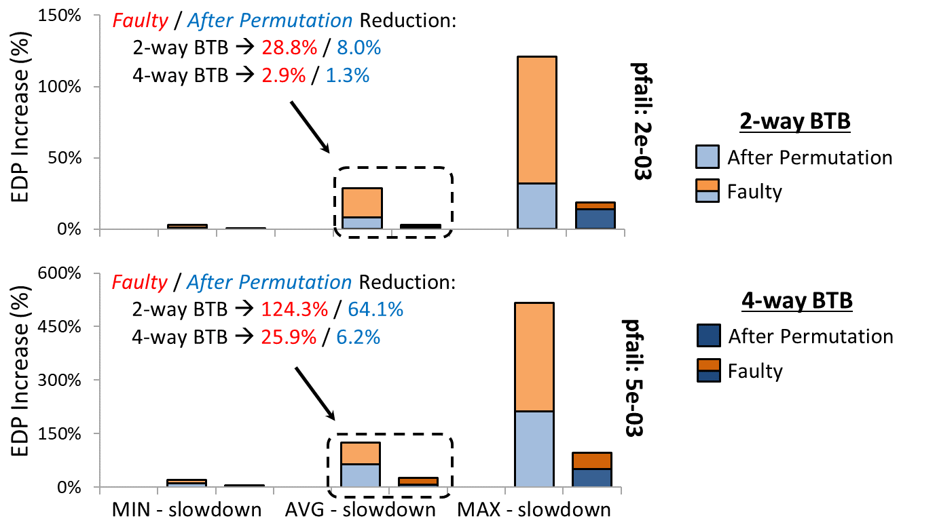
Evaluation Results - EDP (Min/Avg/Max)
50% ∼ 80% energy recovery on average!
Energy ⬇
Filippos Filippou

Slide 24
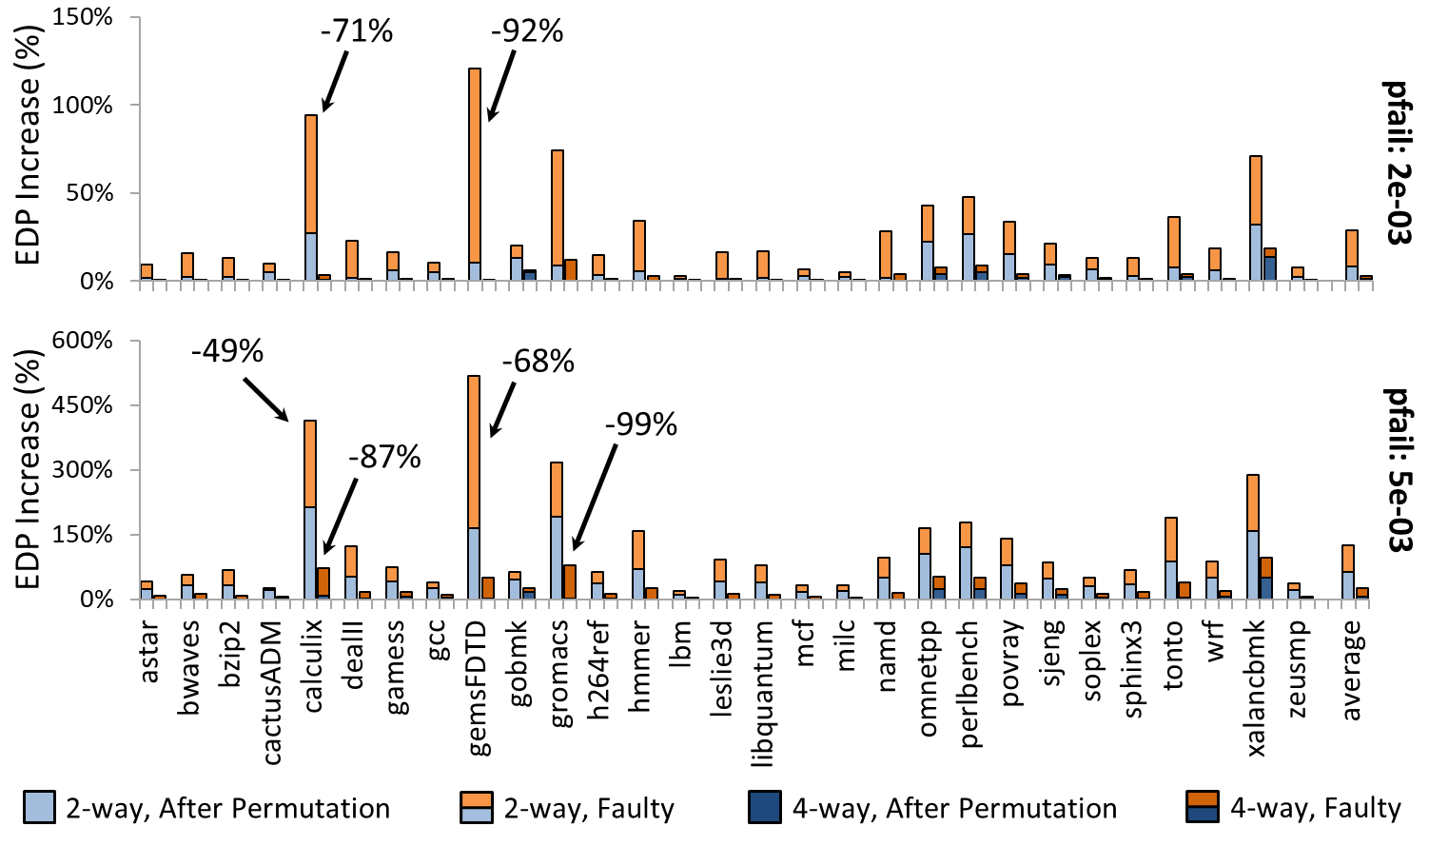
Evaluation Results - EDP (Total)
Significant cases with even more than 80% EDP recovery!!
Filippos Filippou

Slide 25
When a BTB permutation is useful ?
Additional contribution:
Practical considerations for BTB designers!
Two important questions:
Which probabilities of failure?
Which pipeline/machine configurations ?
Filippos Filippou

Slide 26
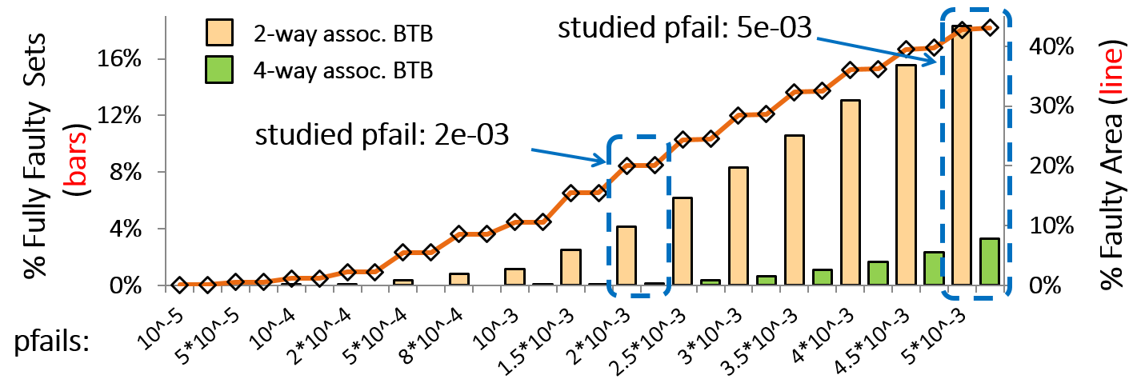
Failure Probability and effect in BTB
Faulty Case
(without permutation)
Critical parameter: fully faulty sets
Lower failure probabilities (pfail < 1.5e-03) ⇨ fully faulty sets < 1%
Two selected probabilities:
Medium → 2e-03 (20% faulty blocks, 4% fully faulty sets [2-way])
High → 5e-03 (40% faulty blocks, 18% fully faulty sets [2-way])
Filippos Filippou

Slide 27
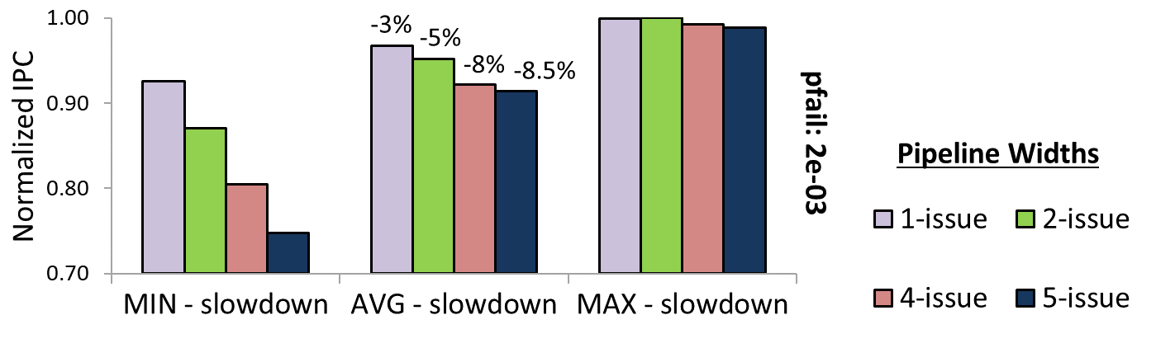
Microarchitecture Configuration
Faulty Case
(without permutation)
Why an aggressive processor?
Aggressive processors:
more potential to exploit ILP → need for branch prediction & BTBs
For a mid pfail (2e-03) → performance degradation is higher in
4 or 8-issue superscalar processors!
Filippos Filippou

Slide 28
Conclusions
Exploration of Branch Prediction Mechanism behavior
under ultra-low voltage operation
Characterization of a Brach Target Buffer:
in ultra-low voltage operation
for different Pipeline and BTB configurations
Introduction of the first fault tolerant technique for Branch Target Buffers with negligible overhead!
Result ⇨ 50% ∼ 70% performance & energy recovery
with overhead < 1% of the original BTB!
Filippos Filippou

Slide 29
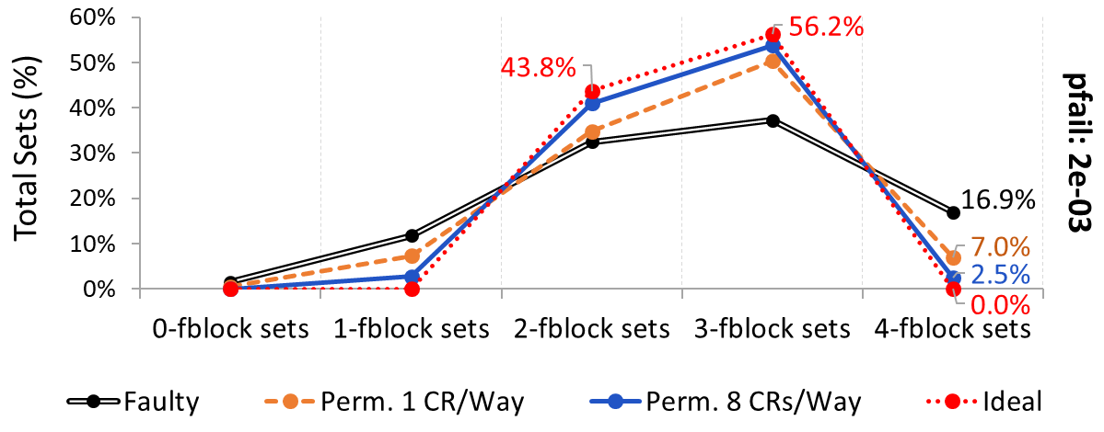
Future Work
Why not in L1 CACHE?
The first results
Under Preparation!
32kB / 4-way / 64-byte block
pfail: 2e-03 → 64% faulty blocks
Filippos Filippou

Slide 30
Publications
Already published:
F. Filippou, G. Keramidas, M. Mavropoulos and D. Nikolos, "Recovery of performance degradation in defective branch target buffers," 2016 IEEE 22nd International Symposium on On-Line Testing and Robust System Design (IOLTS), Sant Feliu de Guixols, 2016, pp. 96-102.
Ready to be submitted:
F. Filippou, G. Keramidas, M. Mavropoulos and D. Nikolos, “Performance degrading faults in branch target buffers: exploration and remedy”
Under preparation:
F. Filippou, G. Keramidas, M. Mavropoulos and D. Nikolos, “Graceful Degradation of Time Sensitive First-level Faulty Caches Using Address Permutation”
Filippos Filippou

Slide 31
Thank You! ☺

